Slide 1



SWIRE INNOVATORS
Sai Eshwar Abhiram Mannam Kushal Ram

Slide 2

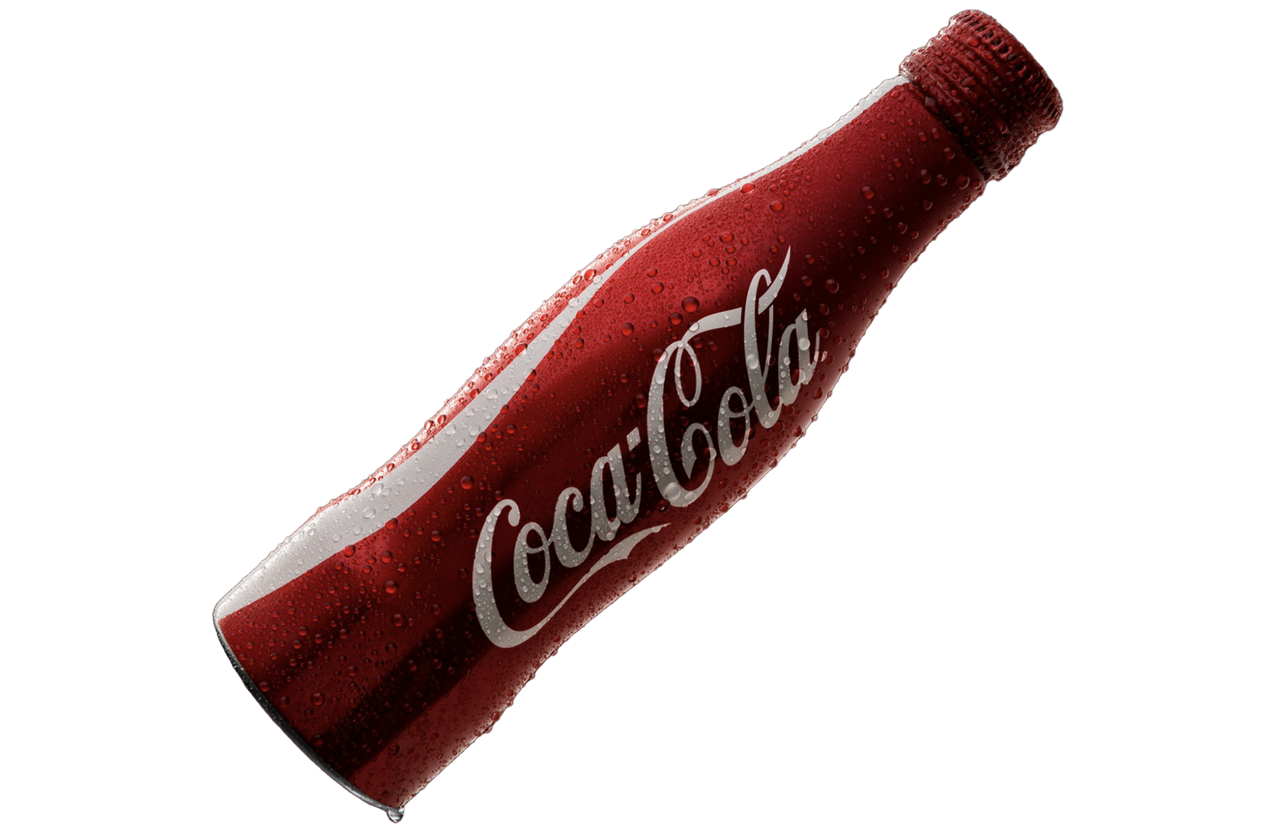
BUSINESS PROBLEM
Accurately predict the demand for each innovative beverage product to streamline production process and consumer needs efficiently.
Ensure efficient resource allocation, boosts customer satisfaction, strengthen brand loyalty, drive more sales performance, and increase profitability.
IMPACT

Slide 3

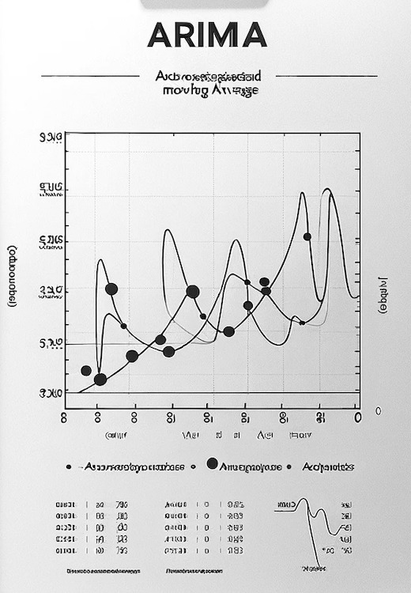
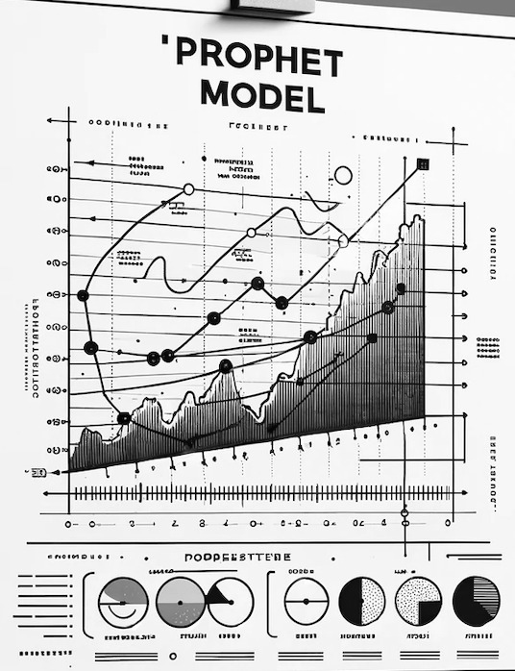
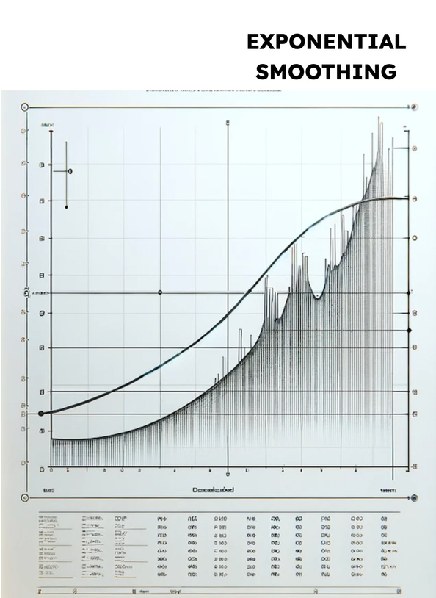
HOW CAN WE ANALYZE
Time Series Forecasting
EXPONENTIAL SMOOTHING
ARIMA
PROPHET
Combines autoregressive, integrated, and moving average components to capture temporal patterns in data.
Based on an additive regression models where non-linear trends are fit.
Uses weighted averages of past observations to predict new values.

Slide 4
INNOVATIVE PRODUCT
Item Description: Diet Venomous Blast Energy Drink Kiwano 16 Liquid Small
Which 13 weeks of the year would this product perform best in the market?
What is the forecasted demand, in weeks, for those 13 weeks?
SWIRE CC
ENERGY
DIET
VENOMOUS BLAST
KIWANO
16 LIQUID SMALL
Manufacturer
Category
Caloric Segment
Brand
Flavor
Package

Slide 5
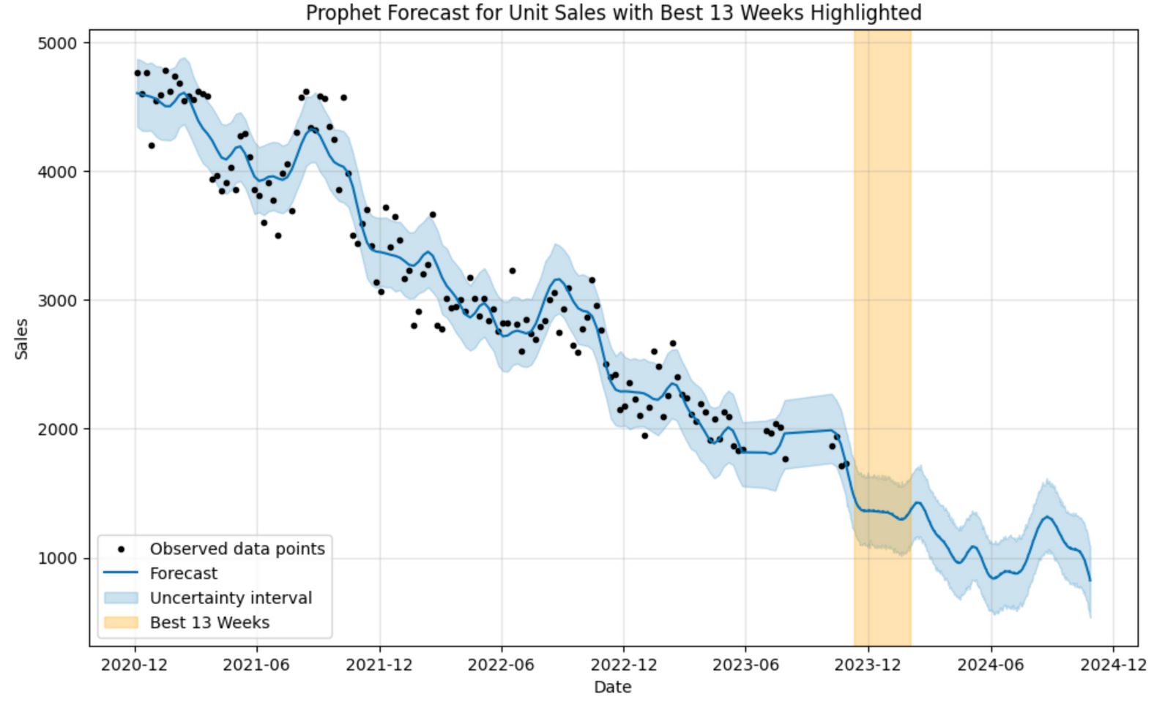
Swire-CC, Diet/Light, Energy, and Venomous Blast
Prophet Model
Best 13 weeks -
2023-11-05 to 2024-02-04
Total sales are around 27000 - 27100

Slide 6
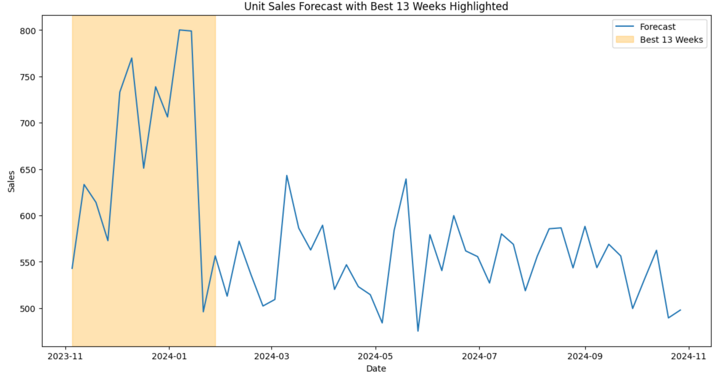
Kiwano flavor with Swire-CC, Energy, and Diet/Light Caloric segment.
Exponential Smoothing Model
Best 13 weeks -
2023-11-05 to 2024-02-04
Total sales are around
8600- 8650

Slide 7
INNOVATIVE PRODUCT
Peppy Gentle Drink Pink Woodsy .5L Multi Jug
Swire plans to release this product in the Southern region for 13 weeks.
What will the forecasted demand be, in weeks, for this product?
SWIRE CC
SSD
REGULAR
PEPPY
PINK WOODSY
.5L MULTI JUG
Manufacturer
Type
Caloric Segment
Brand
Flavor
Package

Slide 8
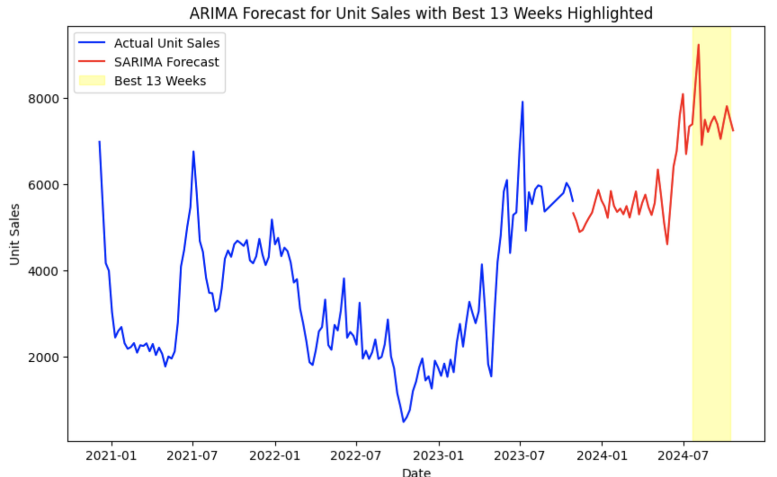
Peppy brand with Swire-CC, category SSD, and Regular caloric segment in Southern Regions like KS, UT, CA, CO, AZ, NM, NV
ARIMA Model
Best 13 weeks -
2024-7-14 to 2024-10-12
Total sales are around
90700- 98400

Slide 9
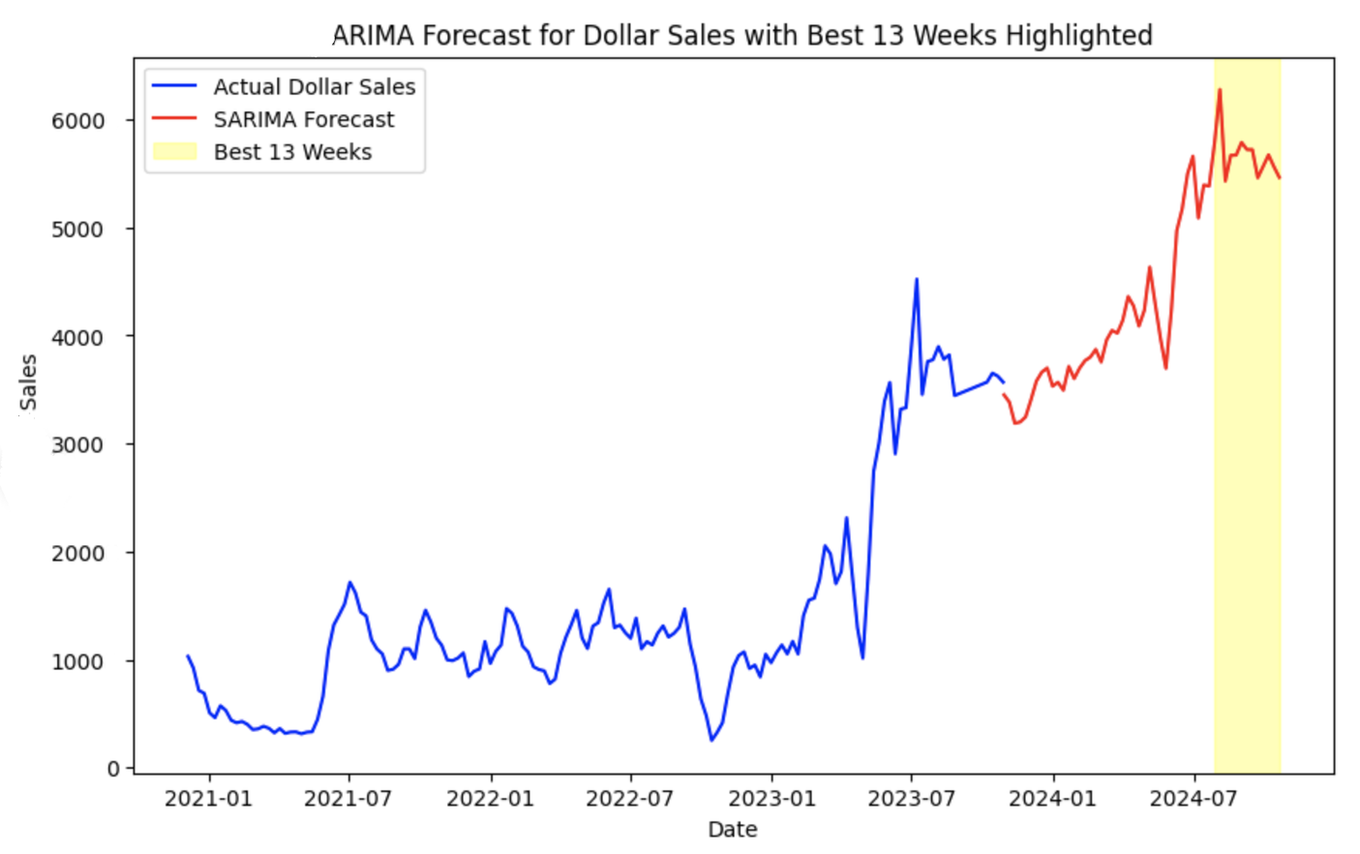
Package type .5L Multi Jug with Swire-CC, category of SSD and Regular caloric segment in Southern Regions like KS, UT, CA, CO, AZ, NM, NV
ARIMA Model
Best 13 weeks -
2024-07-14 to 2024-10-12
Total sales are around
78100- 78200

Slide 10
INNOVATIVE PRODUCT
Sparkling Jacceptabletlester Avocado 11Small MLT
Swire plans to release this product 2 weeks prior to Easter and 2 weeks post-Easter. What will the forecasted demand be, in weeks, for this product?
SWIRE CC
SSD
REGULAR
SPARKLING JACCEPTABLETLESTER
AVOCADO
11 SMALL MLT
Manufacturer
Type
Caloric Segment
Flavor
Package
Brand

Slide 11
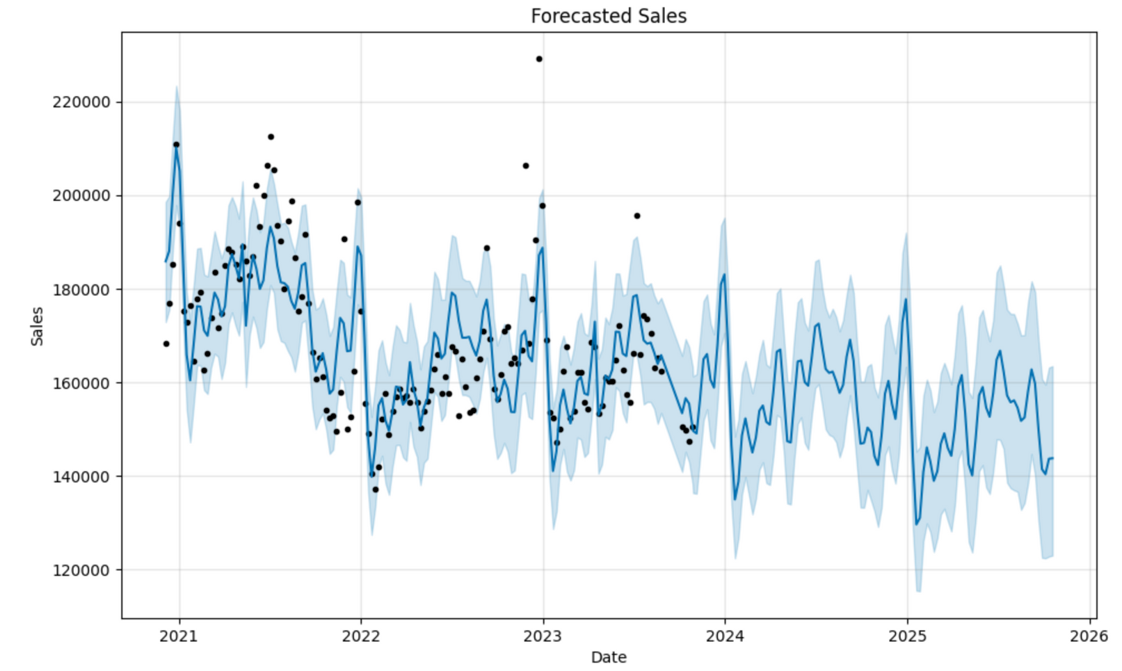
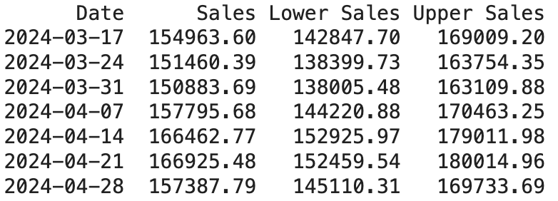

Regular, Swire-CC, SSD, and Sparkling Jacceptabletlester
Prophet Model

Slide 12

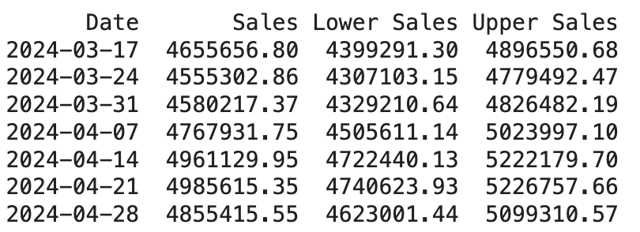
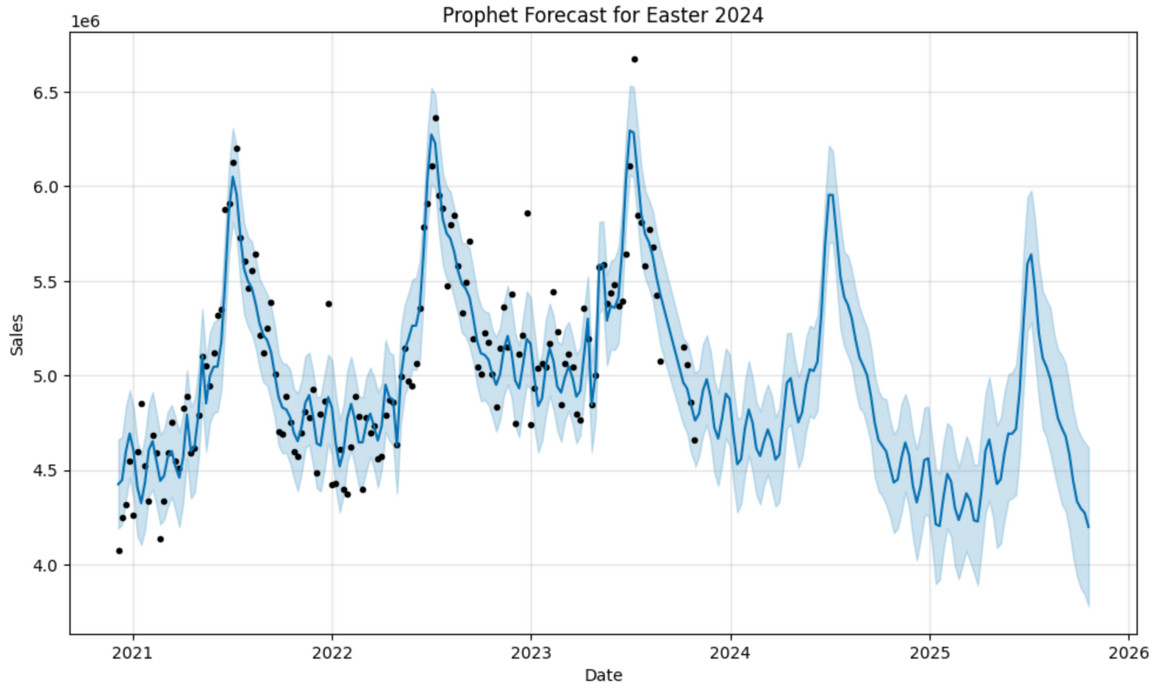
Non-Swire - CC Manufacturer, and Avocado flavor with category of SSD and Regular
Prophet Model

Slide 13
RECOMMENDATIONS
INNOVATIVE PRODUCT | BEST WEEKS / UNIT SALES
Item Description: Diet Venomous Blast Energy Drink Kiwano 16 Liquid Small
Which 13 weeks of the year would this product perform best in the market?
What is the forecasted demand in weeks for those 13 weeks?
2023-11-05 to 2024-02-04
Peppy Gentle Drink Pink Woodsy .5L Multi Jug
Swire plans to release this product in the Southern region for 13 weeks.
What will the forecasted demand be, in weeks, for this product?
2024-07-21 to 2024-10-03
Sparkling Jacceptabletlester Avocado 11Small MLT
Swire plans to release this product 2 weeks prior to Easter and 2 weeks post-Easter. What will the forecasted demand be, in weeks, for this product?
142847 to 179000

Slide 14

Inflation Resilience
Coffee Revitalization
Avocado Demand Surge
Mulberry Niche Appeal
Western Market Dominance
Seasonal Sales Peak

Slide 15

FUTURE
Surveys
Recommendations
AI Analysis
https://swirewebsite-kxgpyieata-wm.a.run.app/

Slide 16




Thank you!

